Slide 1
Flight Delay Predictions
Melissa Nielsen and Sebastien Garneau

Slide 2
Introduction

Slide 3
Objective
Predict lateness of flights in Jan 2020 using a regression model

Slide 4
Scope
Create machine learning model based on US domestic flights from 2018 and 2019
Use to predict January 2020 flights

Slide 5
Project Approach

Slide 6
Modeling and feature engineering were an iterative process
Data Preparation
- import data, basic cleaning
EDA
Part 1
- explore flight data
- answer LHL questions)
Feature Engineering
Part 1
- get weather
- get additional airport features
- find airport busyness
EDA
Part 2
- understand how new features affect data
- understand correlations
Feature Engineering
Part 2
- refine features
- bin airlines and hours
- improve weather features
Modeling
- linear regression
- polynomial regression
- XGBoost
EDA and feature engineering were an iterative process

Slide 7
Project Implementation

Slide 8
Data Preparation and Cleaning
EDA
Part 1
Feature Engineering
Part 1
EDA
Part 2
Feature Engineering
Part 2
Modeling
Collect & Import Datasets (flights details, passengers, airport details, airport weather)
Cleaning (rename columns, outliers, missing values, and duplicates)
ID column to join all collected information into a single table to run our models on
Notes:
Sebastien

Slide 9
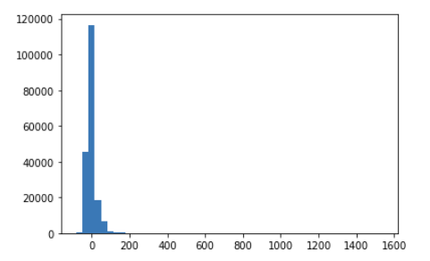
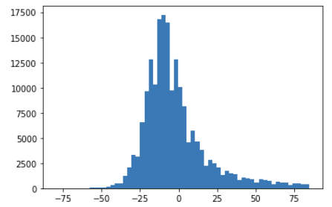
Data Preparation
EDA
Part 1
Feature Engineering
Part 1
EDA
Part 2
Feature Engineering
Part 2
Modeling
Removed outliers
(+/- 3+ std from mean)
Late Arrivals were right-skewed

Slide 10
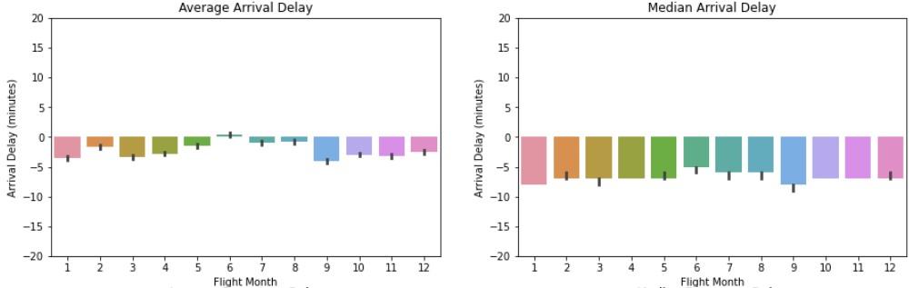
Data Preparation
EDA
Part 1
Feature Engineering
Part 1
EDA
Part 2
Feature Engineering
Part 2
Modeling
June is the only month with an average delay
Median very different than average due to right-skewness of distribution
June had the latest flights

Slide 11
Data Preparation
EDA
Part 1
Feature Engineering
Part 1
EDA
Part 2
Feature Engineering
Part 2
Modeling
Carrier delay
Weather delay
National air system delay
Departure delay
Arrival delay
Security delay
Late aircraft delay
70% of planes that left late arrived late!
BUT…

Slide 12
Data Preparation
EDA
Part 1
Feature Engineering
Part 1
EDA
Part 2
Feature Engineering
Part 2
Modeling
Late planes flew faster!
Average speed of airplane
It doesn’t look like much, but a z-test demonstrated that late planes fly faster
(12 miles faster per hour)

Slide 13
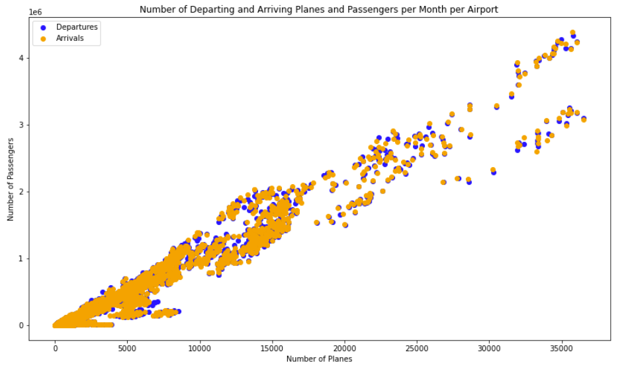
Data Preparation
EDA
Part 1
Feature Engineering
Part 1
EDA
Part 2
Feature Engineering
Part 2
Modeling
Busy-ness of airports – number of passengers is closely correlated with number of planes

Slide 14
Data Preparation
EDA
Part 1
Feature Engineering
Part 1
EDA
Part 2
Feature Engineering
Part 2
Modeling
weather | Precipitation, snowfall, temperature, wind speed, fog, thunder. Origin & destination.
busy-ness | Compared busy-ness of a day to average day at a given airport
passenger information | Pulled average passengers, percent seats full, payload. Per route done by a carrier.
hours of departure and arrival | One-hot encoded
Notes:
Sebastien

Slide 15
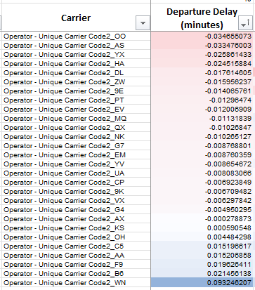
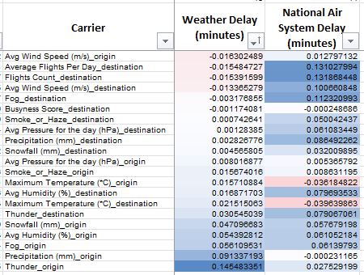
Data Preparation
EDA
Part 1
Feature Engineering
Part 1
EDA
Part 2
Feature Engineering
Part 2
Modeling
Examples
Finding: correlation between departure delay and carrier
Finding: weather caused both weather delays and NAS delays
Findings were interesting, but the models worked better with all the variables, not just those that appeared to have a correlation

Slide 16
Data Preparation
EDA
Part 1
Feature Engineering
Part 1
EDA
Part 2
Feature Engineering
Part 2
Modeling
One-hot encoded the carriers
Limited and tweaked weather data used in model

Slide 17
Data Preparation
EDA
Part 1
Feature Engineering
Part 1
EDA
Part 2
Feature Engineering
Part 2
Modeling
Tried:
Linear regression (including ridge, lasso)
Random Forest Regressor
SVM
Random Forest Classifier
XGBoost
XGBoost performed best!
but so far, only 8% better than mean

Slide 18
Data Preparation
EDA
Part 1
Feature Engineering
Part 1
EDA
Part 2
Feature Engineering
Part 2
Modeling
XGBoost Details
used tree base model
Tunable Parameters
learning rate – learning rate/eta
gamma – min loss reduction to create new tree split
lambda – L2 reg on leaf weights
alpha – L1 reg on leaf weights
max_depth – max depth per tree
subsample - % samples used per tree

Slide 19
Data Preparation
EDA
Part 1
Feature Engineering
Part 1
EDA
Part 2
Feature Engineering
Part 2
Modeling
Used GridSearchCV to find best hyperparameters…
Stay tuned!

